Slide 1

Lane Detection
Manish Pandey,
MTech, Data Science
2022pds0024@iitjammu.ac.in

Slide 2
Introduction
Lane Detection is a project that focuses on developing a system for accurate detection and visualization of lane lines on roads.
The project utilizes computer vision techniques and image processing algorithms to identify lane lines in real-time from input images or videos.
The primary goal of this project is to improve road safety by providing a visual representation of detected lane lines, enabling autonomous vehicles to navigate within lanes and make informed decisions.
This project has significant applications in the field of autonomous driving systems, where precise lane tracking is essential for ensuring safe and efficient navigation, contributing to the advancement of autonomous vehicle technology.

Slide 3
Importance of Lane Detection in Autonomous Driving Systems:
Autonomous vehicles rely heavily on computer vision and sensor technologies to perceive the environment and make informed decisions.
Lane detection enables autonomous vehicles to stay within designated lanes.
Accurate lane detection improves vehicle safety, reduces accidents, and enhances overall driving experience.

Slide 4
Lane Detection Pipeline
Gray Scale
Gaussian Smoothing
Canny Edge Detection
Region Masking
Hough Transform
Draw Lines [Mark Lane Lines with different Color]

Slide 5
Gray scaling
Processing of single channel is faster that three channel processing.
0 to 355 0 to 255
3 channel 1 channel

Slide 6
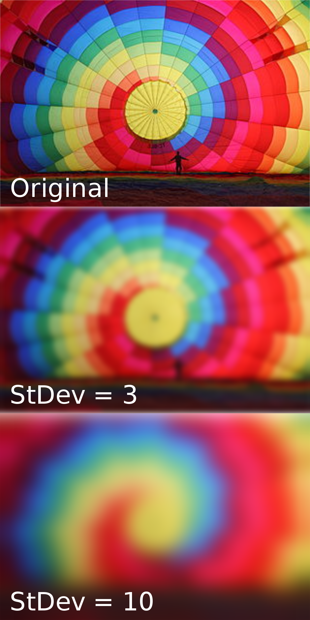
Gaussian Smoothing
Noise can be defined as unnecessary information in a image or video.
Reducing the noise with Gaussian filter by modify the value of the pixels to the average values of the pixels.
Smooth out the image before applying Canny edge detection so we do not detect faint edges

Slide 7
Edge Detection
Edge detection refers to process of identifying and locating sharp discontinuities in an Image.
Different methods:
Sobel Operator
Laplacian of Gaussian filter
Canny Edge Detection Algorithm
Why Canny edge detection is more optimal?
Less sensitive to noise
It removes streaking by using two thresholds high and low
Offers good localization of edges and utilizes gradient of the edge to generate thin edges

Slide 8

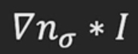

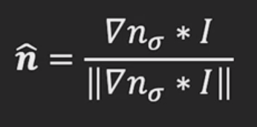
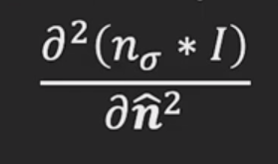
Canny Edge Detection
Algorithm:
Smooth image with 2D gaussian :
Compute image gradient with sobel operator:
Find gradient magnitude at each pixel:
Find gradient orientation at each pixel:
Compute Laplacian along the gradient direction at each pixel:
Find zero crossings in Laplacian to find the edge location

Slide 9
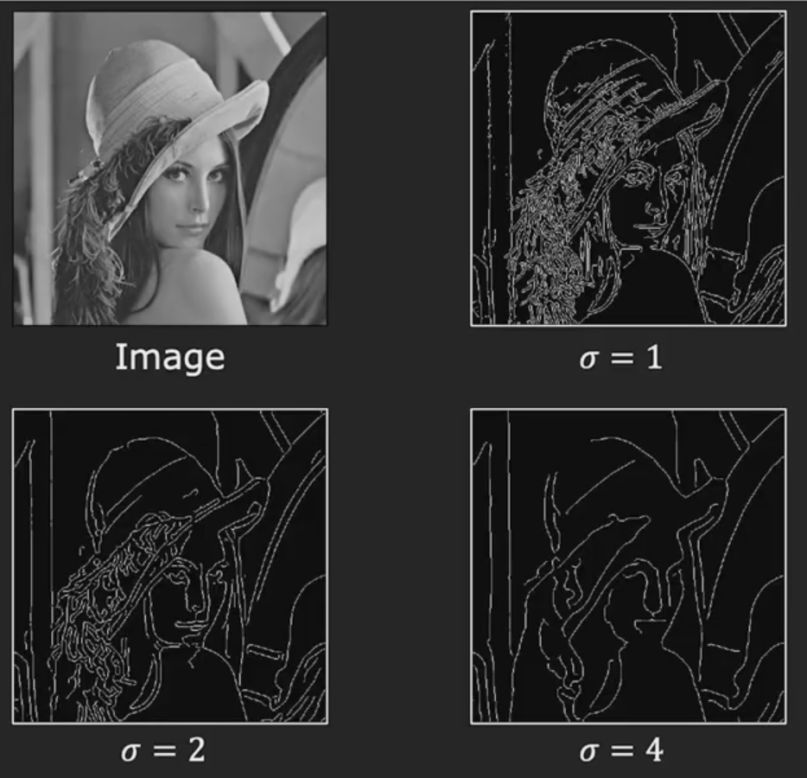
Canny edge detection results

Slide 10
Region Masking
We want to narrow down our analysis to a section of the image. We use masking for this purpose.
We start by creating a blank mask with the same shape as the input image.
Create a polygonal mask over the vertices.
Apply the polygonal mask to the original image resulting in a masked image over the region of interest.

Slide 11
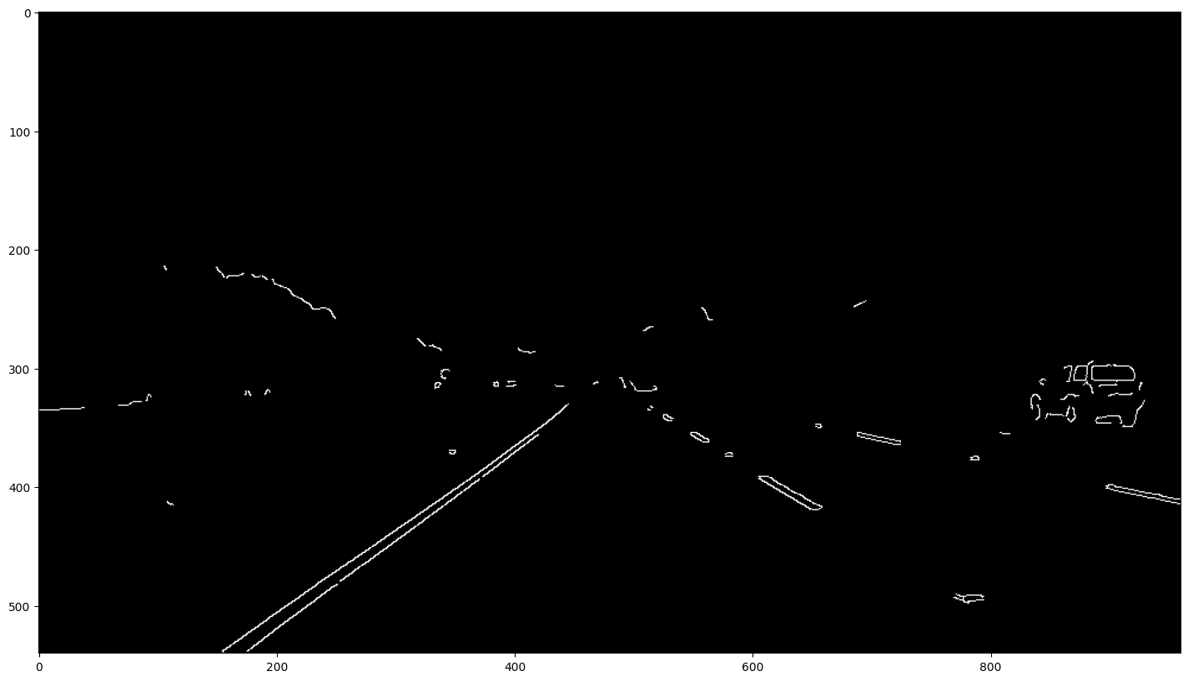
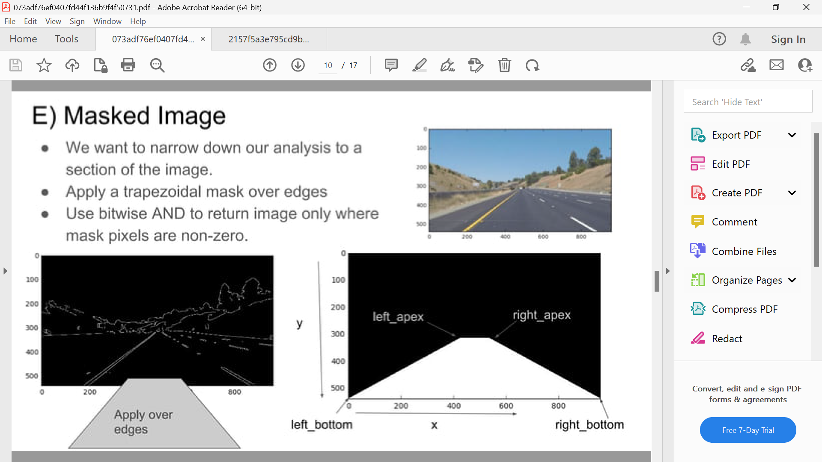
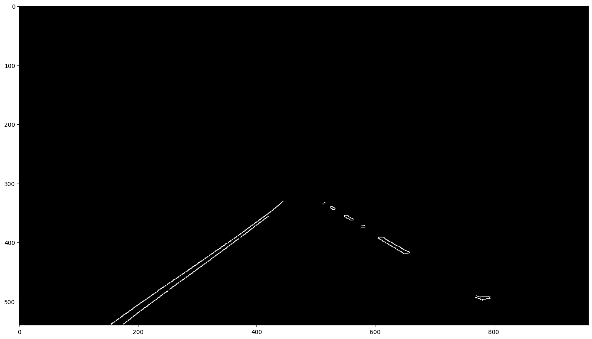
Masking Process

Slide 12
Difficulties for fitting approach
Extraneous data : Which points to fit to?
Incomplete data : Only parts of the image is
visible
Noise
Solution: Hough Transform

Slide 13
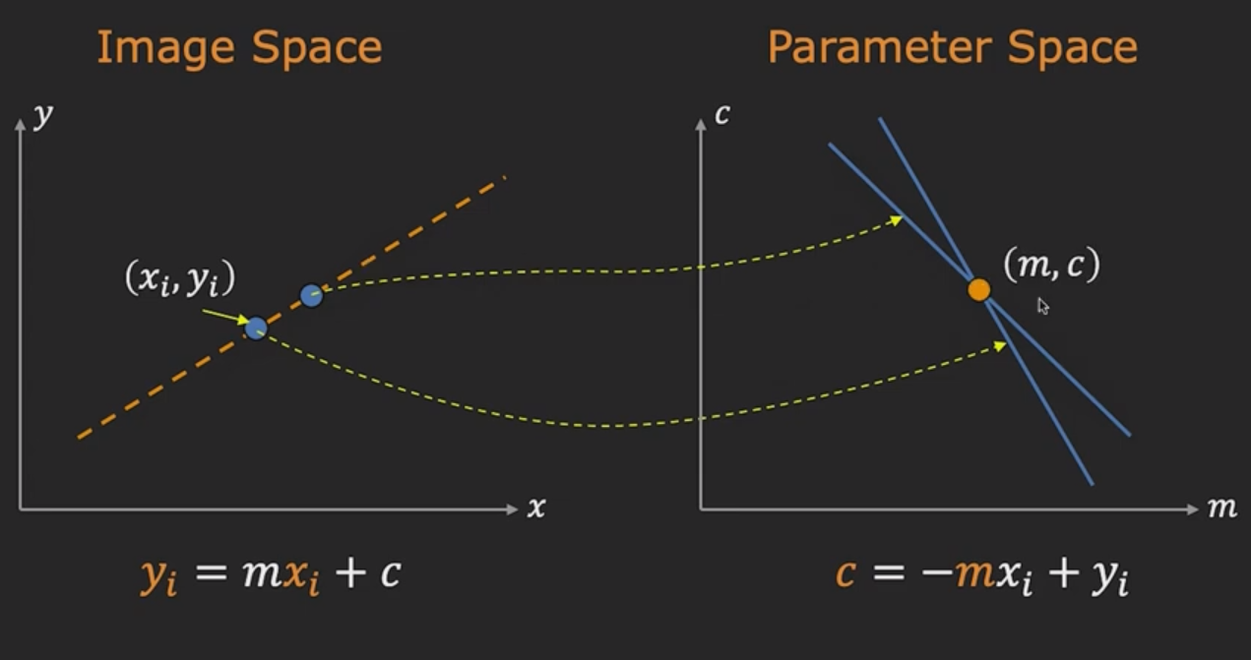
Hough Transform: Concept

Slide 14
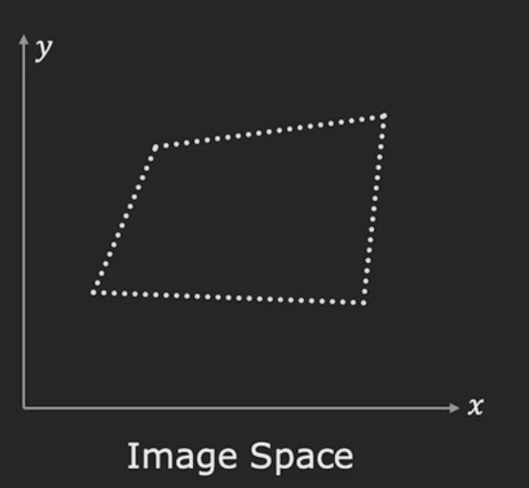
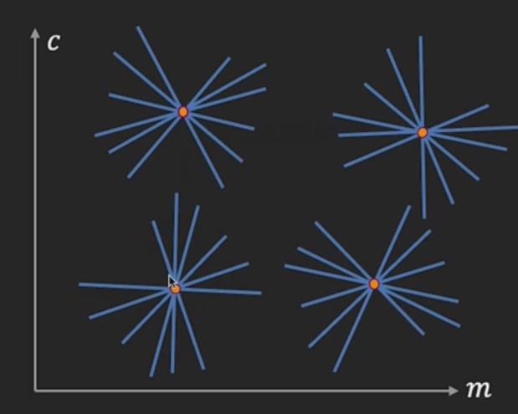
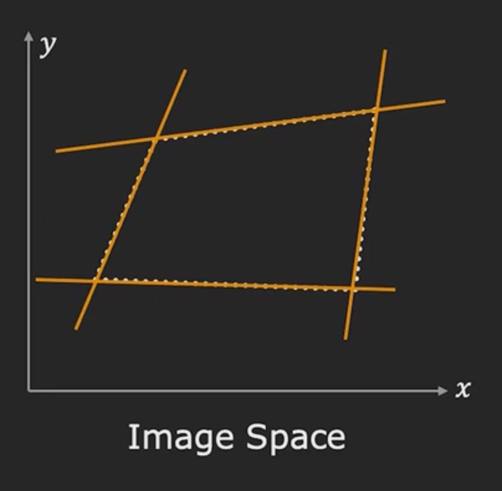
Multiple Line detection

Slide 15
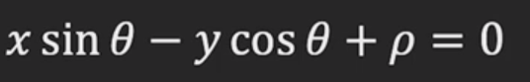
Better Parameterization
Issue:
Slope of the line could be very large or very small
More memory and computation
Solution:
Use
Orientation of θ is finite ,i.e. it is between 0º and 180⁰
Distance ρ is finite.

Slide 16
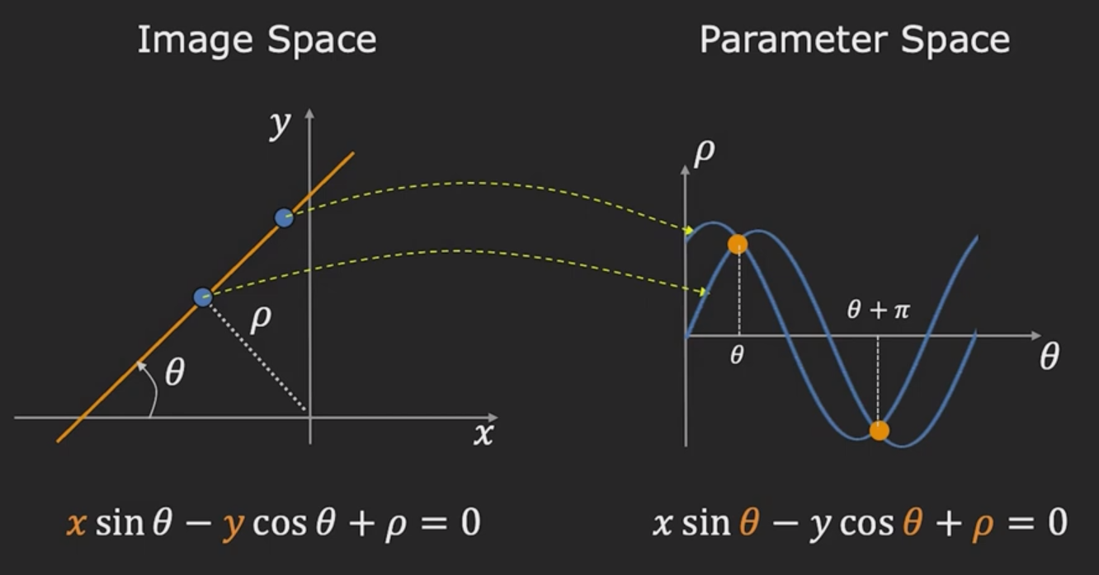
Better Parameterization

Slide 17
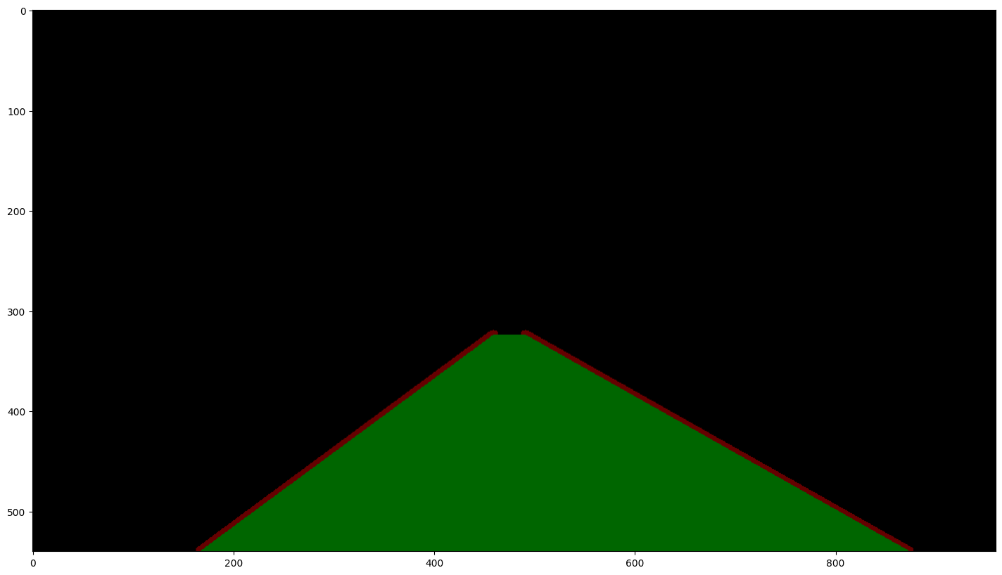
Hough Transform
We perform Hough Transform to detect line (lane) from a video

Slide 18
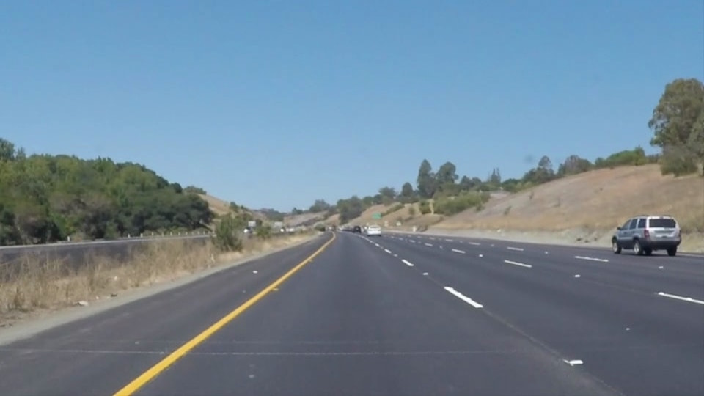
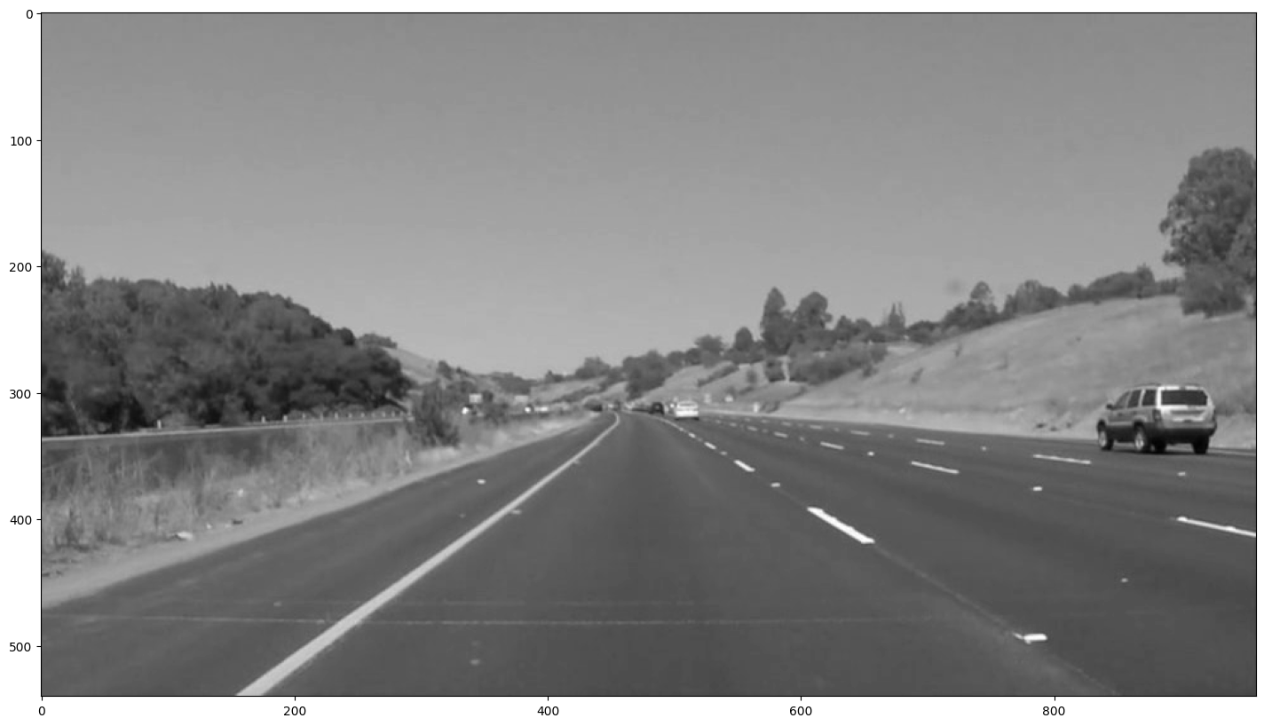
Pipeline Outputs
Gray scaling

Slide 19
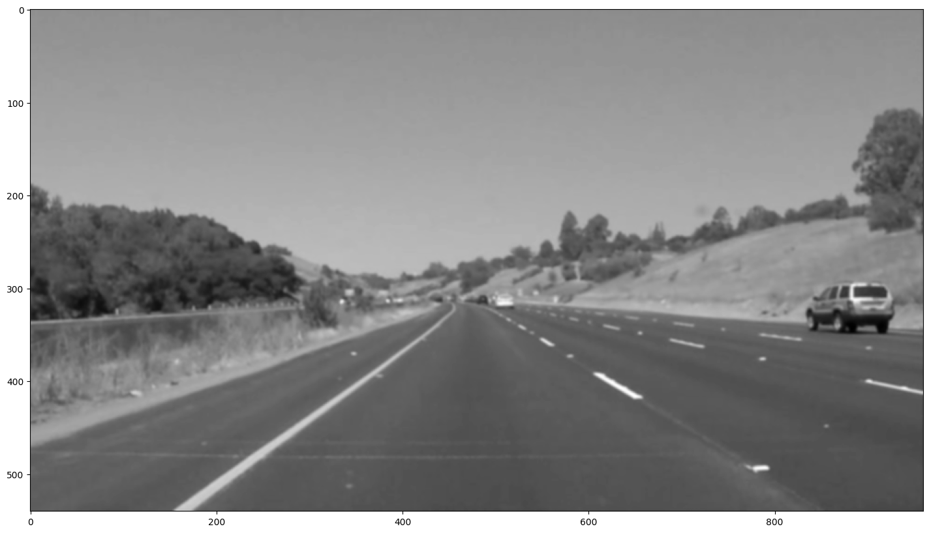
Pipeline Outputs
Gaussian Smoothing

Slide 20
Pipeline Outputs
Canny Edge Detection

Slide 21
Pipeline Outputs
Region Masking

Slide 22
Pipeline Outputs
Hough Transform

Slide 23
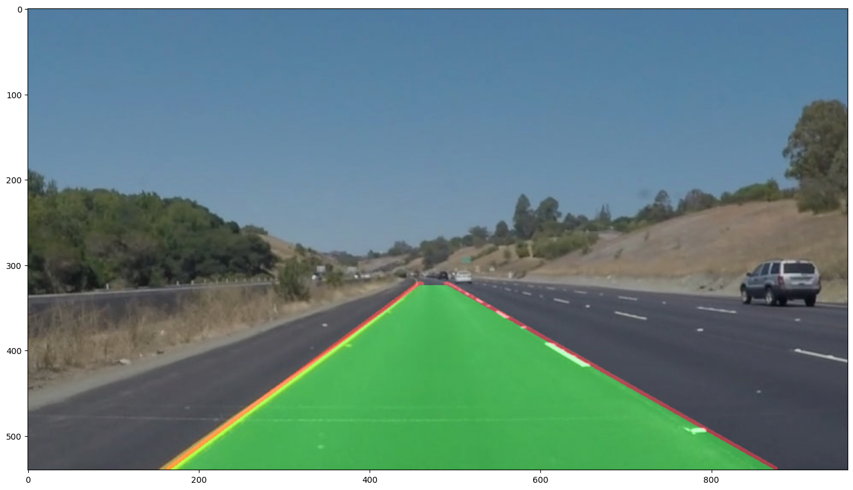
Final Output

Slide 24
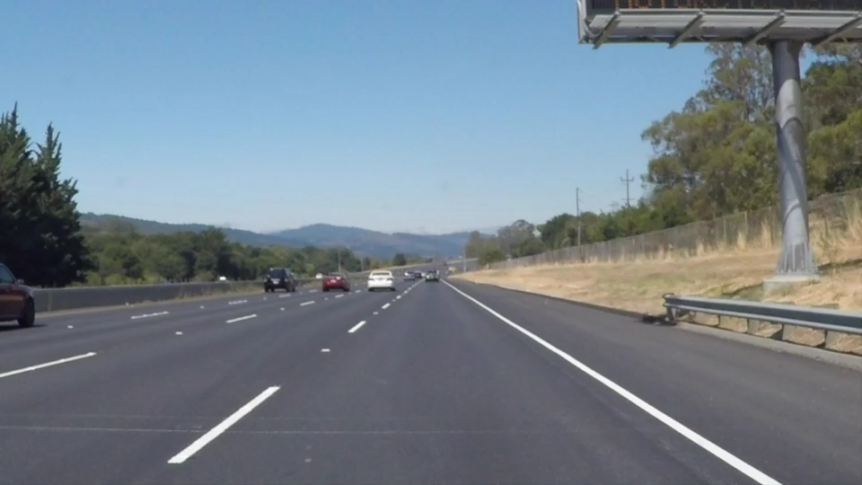
Input video

Slide 25
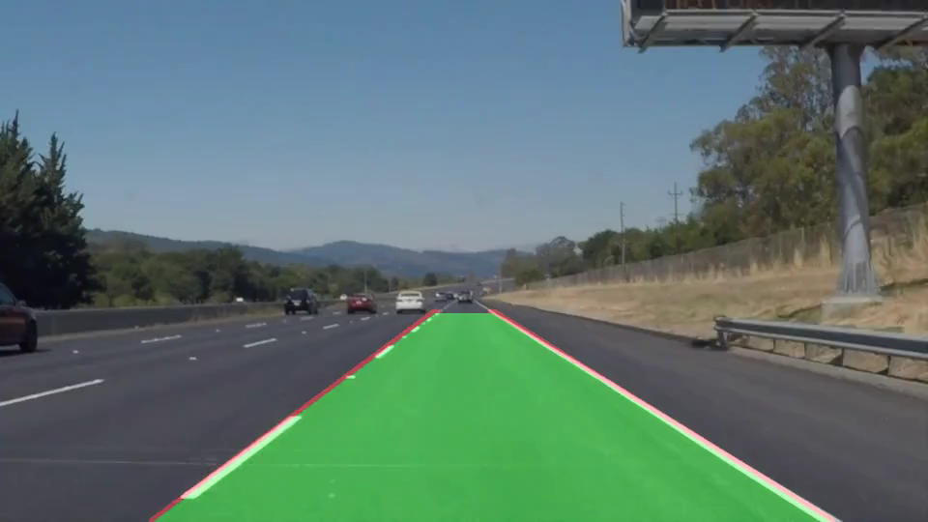
Output video

Slide 26
Thank You!

